Slide 1
COMPUTER ARCHITECTURE & ORGANIZATION
Notes:
Manav Rachna College of Engineering

Slide 2
INTRODUCTION
Every different processor type has its own design (different registers, buses, microoperations, machine instructions, etc)
Modern processor is a very complex device
It contains
  Many registers
  Multiple arithmetic units, for both integer and floating point calculations
  The ability to pipeline several consecutive instructions to speed execution
  Etc.
However, to understand how processors work, we will start with a simplified processor model. This is similar to what real processors were like ~25 years ago
M. Morris Mano introduces a simple processor model he calls the Basic Computer.

Slide 3
INSTRUCTION CODES
Program
  A sequence of (machine) instructions
(Machine) Instruction Codes
  A group of bits that tell the computer to perform a specific operation (a sequence of micro-operation)
  It is usually divided into parts, each having its own particular interprettion.
The instructions of a program, along with any needed data are stored in memory
The CPU reads the next instruction from memory
It is placed in an Instruction Register (IR)
Control circuitry in control unit then translates the instruction into the sequence of microoperations necessary to implement it

Slide 4
THE BASIC COMPUTER
The Basic Computer has two components, a processor and memory.
The memory has 4096 words in it
  4096 word = 2¹², so it takes 12 bits to select a word in memory
Each word is 16 bits long
CPU
RAM (4096 x 16)
0
15
0
4095

Slide 5
INSTRUCTION FORMAT
A computer instruction is often divided into two parts
  An opcode (Operation Code) that specifies the operation for that instruction
  An address that specifies the registers and/or locations in memory to use for that operation
In the Basic Computer, since the memory contains 4096 (= 2¹²) words, we needs 12 bit to specify which memory address this instruction will use
In the Basic Computer, bit 15 of the instruction specifies the addressing mode (0: direct addressing, 1: indirect addressing)
Since the memory words, and hence the instructions, are 16 bits long, that leaves 3 bits for the instruction’s opcode
Instruction Format
15
14
12
11
0
I
Opcode
Address
Addressing
mode

Slide 6





The address field of an instruction can represent either
  Direct address: the address in memory of the data to use (the address of the operand), or
  Indirect address: the address in memory of the address in memory of the data to use
Effective Address (EA)
  The address, that can be directly used without modification to access an operand for a computation-type instruction, or as the target address for a branch-type instruction
Direct addressing
Indirect addressing
22
ADD
35
ADD
300
457
Operand
1350
Operand
+
+
AC
AC

Slide 7
COMPUTER REGISTERS
Registers in the Basic Computer
11
0
PC
Memory
11
0
4096 x 16
AR
15
0
IR
CPU
15
0
15
0
TR
DR
7
0
7
0
15
0
OUTR
INPR
AC
List of BC Registers
  DR 16 Data Register Holds memory operand
  AR 12 Address Register Holds address for memory
  AC 16 Accumulator Processor register
  IR 16 Instruction Register Holds instruction code
  PC 12 Program Counter Holds address of instruction
  TR 16 Temporary Register Holds temporary data
  INPR 8 Input Register Holds input character
  OUTR 8 Output Register Holds output character

Slide 8
PROCESSOR REGISTERS
A processor has many registers to hold instructions, addresses, data, etc
The processor has a register, the Program Counter (PC) that holds the memory address of the next instruction to get
  Since the memory in the Basic Computer only has 4096 locations, the PC only needs 12 bits
In a direct or indirect addressing, the processor needs to keep track of what locations in memory it is addressing: The Address Register (AR) is used for this
  The AR is a 12 bit register in the Basic Computer
When an operand is found, using either direct or indirect addressing, it is placed in the Data Register (DR). The processor then uses this value as data for its operation.
The Basic Computer has a single general purpose register – the Accumulator (AC)

Slide 9
PROCESSOR REGISTERS
The significance of a general purpose register is that it can be referred to in instructions
  e.g. load AC with the contents of a specific memory location; store the contents of AC into a specified memory location
Often a processor will need a scratch register to store intermediate results or other temporary data; in the Basic Computer this is the Temporary Register (TR)
The Basic Computer uses a very simple model of input/output (I/O) operations
  Input devices are considered to send 8 bits of character data to the processor
  The processor can send 8 bits of character data to output devices
The Input Register (INPR) holds an 8 bit character gotten from an input device
The Output Register (OUTR) holds an 8 bit character to be send to an output device

Slide 10
Instruction Formats

Slide 11
Computer Instruction
A computer will usually have a variety of instruction code formats. It is the function of the control unit within the CPU to interpret each instruction code and provide the necessary control functions needed to process the instruction.

Slide 12
Instruction Formats
It is the representation of the instruction. It contains various Instruction Fields:
opcode field – specify the operations to be performed
Address field(s) – designate memory address(es) or processor register(s)
Mode field(s) – determine how the address field is to be interpreted to get effective address or the operand.
  The number of address fields in the instruction format: depend on the internal organization of CPU
Instruction Format
15
14
12
11
0
I
Opcode
Address
Addressing
mode

Slide 13
Three most common CPU organizations
Computer may have inst. of several different lengths containing varying number of addresses.
Single accumulator organization:
ADD X /* AC ← AC + M[X] */
General register organization:
ADD R1, R2, R3 /* R1 ← R2 + R3 */
ADD R1, R2 /* R1 ← R1 + R2 */
MOV R1, R2 /* R1 ← R2 */
ADD R1, X /* R1 ← R1 + M[X] */
Stack organization:
PUSH X /* TOS ← M[X] */
ADD

Slide 14
Address Instructions
Three-address Instructions
Program to evaluate X = (A + B) * (C + D):
ADD R1, A, B /* R1 ← M[A] + M[B] */
ADD R2, C, D /* R2 ← M[C] + M[D] */
MUL X, R1, R2 /* M[X] ← R1 * R2 */
- Results in short program
- Instruction becomes long (many bits)
- Example is Cyber 170.

Slide 15
Two-address Instructions
Program to evaluate X = (A + B) * (C + D):
MOV R1, A /* R1 ← M[A] */
ADD R1, B /* R1 ← R1 + M[B] */
MOV R2, C /* R2 ← M[C] */
ADD R2, D /* R2 ← R2 + M[D] */
MUL R1, R2 /* R1 ← R1 * R2 */
MOV X, R1 /* M[X] ← R1 */

Slide 16
One-address Instructions
- Use an implied AC register for all data manipulation
- Program to evaluate X = (A + B) * (C + D):
LOAD A /* AC ← M[A] */
ADD B /* AC ← AC + M[B] */
STORE T /* M[T] ← AC */
LOAD C /* AC ← M[C] */
ADD D /* AC ← AC + M[D] */
MUL T /* AC ← AC * M[T] */
STORE X /* M[X] ← AC */

Slide 17
Zero-address Instructions
- Can be found in a stack-organized computer
- Program to evaluate X = (A + B) * (C + D):
PUSH A /* TOS ←A */
PUSH B /* TOS ←B */
ADD /* TOS ← (A + B) */
PUSH C /* TOS ←C */
PUSH D /* TOS ←D */
ADD /* TOS ← (C + D) */
MUL /* TOS ← (C + D) * (A + B) */
POP X /* M[X] ← TOS */

Slide 18
RISC Instructions
Program to evaluate X = (A + B) * (C + D):
LOAD R1, A /* R1 ← M[A] */
LOAD R2, B /* R2 ← M[B] */
LOAD R3, C /* R3 ← M[C] */
LOAD R4, D /* R4 ← M[D] */
ADD R1, R1, R2 /* R1 ← R1 + R2 */
ADD R3, R3, R4 /* R3 ← R3 + R4 */
MUL R1, R1, R3 /* R1 ← R1 * R3 */
STORE X, R1 /* M[X] ← R1 */

Slide 19
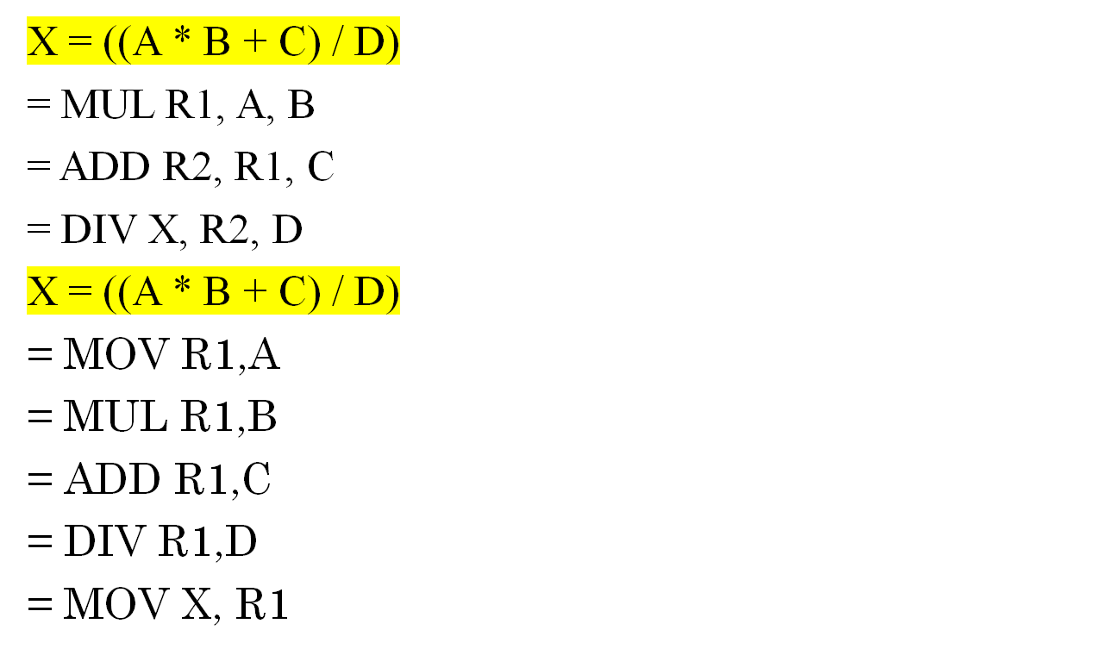
PRACTICE

Slide 20
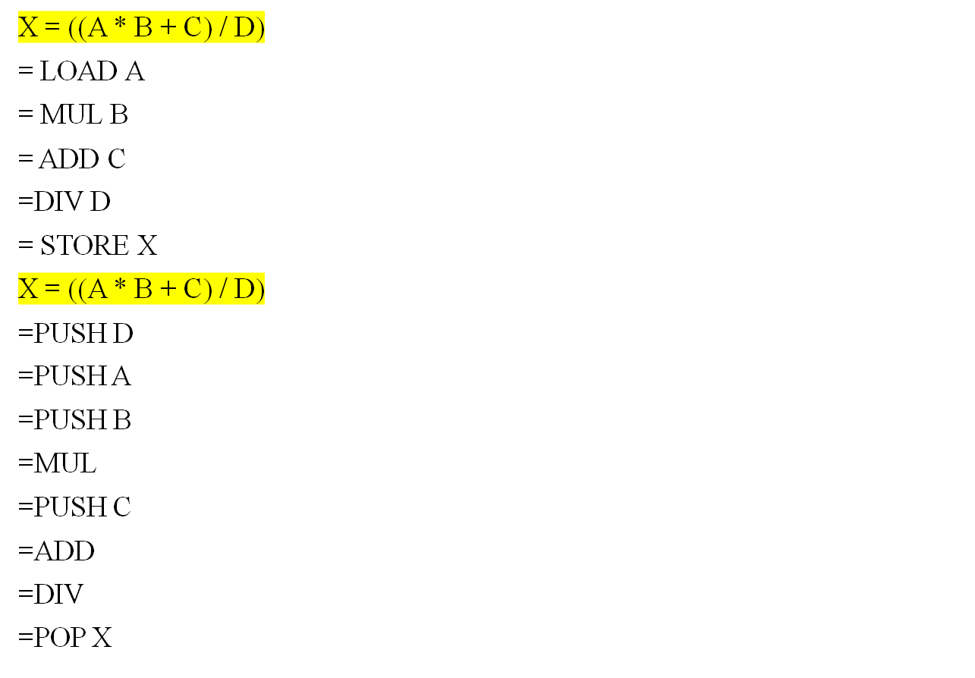
PRACTICE

